Slide 1
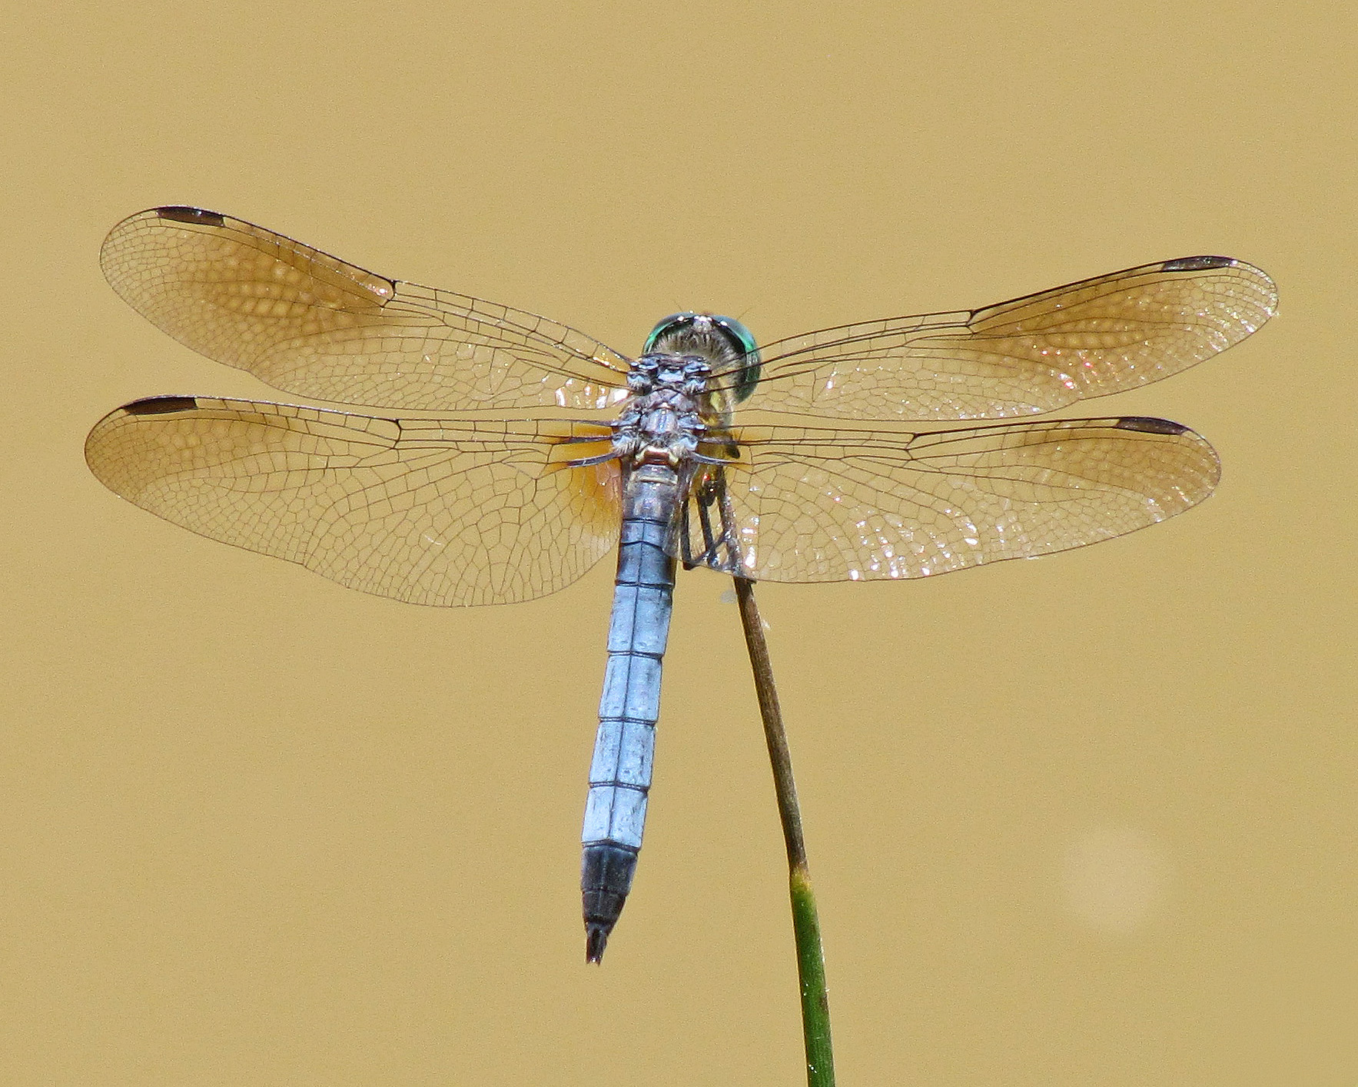
Examining the Antibacterial Surface Properties of Blue Dasher
(Pachydiplax longipennis) Dragonfly Wings
Taylor K. Lewelling and Jeremy D. Blaschke
Union University Department of Biology
Abstract
Methods
Results
The remarkable hydrophobic properties of dragonfly wings may also function as natural antibacterial surfaces. Here, we investigate the ability of Blue Dasher dragonfly wings (Pachydiplax longipennis) to inhibit the growth of the Gram negative bacteria Escherichia coli. Bacteria were genetically transformed to express Green Fluorescent Protein and a microplate reader was used to measure the increase of fluorescence over time as the bacteria colony grew. Dragonfly wings were cut and placed in individual wells of a 96-well plate and covered with nutrient broth. Double-sided sticky tape, glue, and polypropylene plastic were used as control surfaces. When compared to controls, dragonfly wings exhibited significantly less E. coli growth (p<0.05 ) as evidenced by lower expressed fluorescence over time. These results indicate that dragonfly wings may naturally inhibit the formation of biofilms by reducing the growth of Gram negative bacteria. Mimicking the physical structure of these wings could lead to the production of novel synthetic surfaces with antimicrobial properties.
Wing preparation
6mm samples of the wings were removed with a hole punch and sterilized using 75% ethanol
Sections of Ziploc®bags (polypropylene) were used for a negative control and prepared in the same way
Double sided tape or glue dots were added to wells to test variable adhesives
Wing segments or polypropylene sections were secured on top of the adhesive
Transformation of bacteria
Final growth/inhibition of bacteria was quantified using a fluorescence assay in a microplate reader
Fluorescence was induced by transforming bacteria using 5 μL of the pGLO plasmid added directly to frozen bacterial cells which were then heat-shocked to facilitate uptake of the plasmid
Transformed bacteria were then spread onto nutrient agar and incubated at 32°C overnight at 200 rpm
Microplate assay
A single colony was removed from the plate and placed in 5mL of nutrient broth and incubated at 200 rpm and 32°C for 24 hours
Bacteria were then diluted 1:2 in nutrient broth
80 μL of bacterial broth was added to each well of a 96-well plate
Control treatments included wells with bacterial broth alone, tape alone, glue alone, or polypropylene sections adhered with either tape or glue
Test wells included one wing section of P. longipennis adhered with either tape or glue
11–22 replicates of each treatment were included
The microplate was then incubated at 200 rpm and 32°C for 24 hours with fluorescence readings taken every 30 min
The growth curve of each well and the final total fluorescence were then examined statistically to determine if the wells with wings showed inhibited bacterial growth
The broth was then removed and placed into a separate microplate and the fluorescence of the broth alone was measured in order to indirectly quantify the bacteria growing directly on the various substrates
Growth Curves
When using either tape or glue as an adhesive, E.coli growth in the wells that contained P. longipennis wings was significantly less than bacterial growth in wells containing all other treatments (p<0.05) (Figures 3 and 4).
Average Maximum Fluorescence
When glue was used as an adhesive, bacteria with dragonfly wings as a substrate grew significantly less compared to bacteria with polypropylene or tape alone as a substrate (p<0.05) (Figure 5).
When glue was used as an adhesive, bacteria with dragonfly wings as a substrate grew significantly less compared to bacteria with polypropylene, glue alone, or no substrate (p<0.05) (Figure 5).
When tape is used alone or as an adhesive bacterial growth is increased significantly compared to when glue is used alone or as an adhesive (p<0.05) (Figure 5 inset).
Figure 1. Adult Pachydiplax longipennis Photo: Vicki DeLoach
Introduction
Figure 5. Bar graph showing the fluorescence values remaining on each of the surfaces after fluorescence of the broth is removed. Inset shows the combined maximum fluorescence of tape alone and used as an adhesive and glue alone and used as an adhesive.
As antibiotic resistance in bacteria continues to rise, discovering new ways of effectively killing bacteria is increasingly important. Tripathy et al. (2017) describe the serious nature of resistance by explaining that antimicrobial resistant infections are a major cause of death worldwide and that the death toll is likely to increase 14 times by 2050 if this problem is not quickly addressed. One way to combat antibiotic resistance is to kill bacteria using mechanical means rather than chemical.
The physical properties of super-hydrophobic surfaces like the wings of cicadas often include the added benefit of making them bactericidal as well (Ivanova et al. 2012). Microscopically, the bactericidal surfaces consist of nanopillars with different heights that create varying hills and valleys which disrupt the bacteria’s cell wall and cause bacterial death (Tripathy et al. 2017). The super-hydrophobic wings of dragonflies have also shown to have varying degrees of bactericidal properties (Ivanova et al. 2013), but only a few species have been tested to date. In this experiment, the wings of a novel dragonfly species, the Blue Dasher (Pachydiplax longipennis), will be tested for its ability to reduce the growth and/or kill Gram negative (Escherichia coli) bacteria. Our null hypothesis is that there will be no difference in growth of E. coli bacteria on P. longipennis wings when compared to growth on plastic (polypropylene).
Discussion
Results from the growth curves and the maximum fluorescence value both indicate that P. longipennis wings decrease E. coli growth when compared to controls. The null hypothesis that there will be no difference in bacterial growth on P. longipennis wings can be rejected.
The results also indicate that dragonfly wings inhibit formation of biofilms on its surface. According to Yee et al. (2019), biofilms account for 80% of infections and contaminated surfaces. Replicating the physical structure of P. longipennis wings onto different surfaces could decrease the number of infections, decrease antibiotic use, and combat antibiotic resistant bacteria. Reproducing this pattern onto medical devices, such as contact lenses, urinary catheters, and bandages, could dramatically improve health outcomes.
Our results also indicate that double-sided tape significantly increases bacterial growth and promotes biofilm formation on its surface, while glue dots do not significantly affect bacterial growth compared to no substrate controls. The tape may encourage bacterial growth by providing nutrients or additional surface area.
Evaluating the ability of P. longipennis wings to kill Gram positive bacteria and investigating other novel dragonfly wings will provide more insight and possible application of the unique microscopic structure of dragonfly wings.
Figure 3. Growth curves of E. coli over 24 hours with substrates adhered with glue. Values are fluorescence units which correlate to number of bacteria.
80 μL bacterial broth
Literature Cited
Substrate
Tripathy, Abinash., Sen Prosenjit, Su Bo, and Wuge H. Briscoe. 2017. Natural and bioinspired
nanostructured bactericidal surfaces. Advances in Colloid and Interface Science 248: 85– 104.
Ivanova, Elena P., Jafar Hasan, Hayden K. Webb, Gediminas Gervinskas, Saulius
Juodkazis, Vi Khanh Truong, Alex H.F. Wu, Robert N. Lamb, Vladimir A. Baulin, Gregory S. Watson, Jolanta A. Watson, David E. Mainwaring, and Russell J. Crawford. 2013. Bactericidal activity of black silicon. Nature Communications 4: 2838-2845.
Yee, Albert, Rachel Rosenzweig, Mary Nora Disckson, Elena Liang. 2019. Novel anti-bacterial
anti-fungal nanopillared surface. U.S. Patent Application Publication. US 2019/0076573 A1 .
Adhesive
Figure 2. Example microplate well showing adhesive (glue or tape), substrate (dragonfly wings or polypropylene), and bacterial broth.
Figure 4. Growth curves of E. coli over 24 hours with substrates adhered with tape. Values are fluorescence units which correlate to number of bacteria.
Fall 2019

